Slide 1
Booth Analytics Club: Advanced R
Raj Ghosh
October 28, 2017

Slide 2
Agenda
Recap of Last Week
Advanced Regression
Advanced Plotting
R Markdown

Slide 3
Recap of Last Week

Slide 4
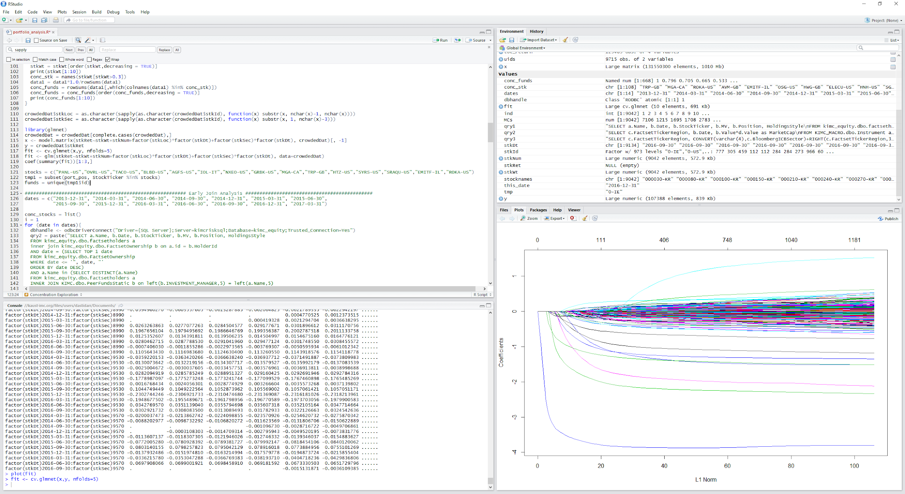
How do you use R?
RStudio is an integrated development environment (IDE) for R
Notes:
Demonstrate the GUI here. Go over tables databases, fields, and properties

Slide 5
Data Types
R has a wide variety of data types:
Scalars: x = 5.0
Vectors: y = c(1,2,5.3,6,-2,4)
Matrices: z = matrix(1:6, nrow=2, ncol=3)
Dataframes: df = data.frame(vec1,vec2)
Lists: w = list(x, y, z, df)
Accessing Vectors, Matrices, DataFrames and Lists:
vec[index], mat[row,col], df[row,col], list[[index]]
Notes:
Demonstrate the GUI here. Go over tables databases, fields, and properties

Slide 6
Loading Data
From File: CSV
read.csv("readcsv.csv", header=T, dec=".",sep="\t")
From Database: SQL
library(RODBC)
dbhandle <- odbcDriverConnect("Driver={SQL Server};Server=Server_Name;Database=DB_Name;Trusted_Connection=Yes")
myDF <- sqlQuery(dbhandle, qry) #qry is in SQL
close(dbhandle)
Notes:
Demonstrate the GUI here. Go over tables databases, fields, and properties

Slide 7
Manipulating Data
Control Structures: R has the standard control structures as in other programming languages. However, it is more efficient to use built-in functions rather than control structures whenever possible.
Control Structure Syntax
If-else: if (cond) {expr1} else {expr2}
For: for (var in seq) {expr}
While: while (cond) {expr}
Notes:
Demonstrate the GUI here. Go over tables databases, fields, and properties

Slide 8
Manipulating Data
Operators:
Arithmetic Operators
Operator Description
+ addition
- subtraction
* multiplication
/ division
^ or ** exponentiation
x %% y modulus (x mod y) 5%%2 is 1
x %/% y integer division 5%/%2 is 2
Logical Operators
Operator Description
< less than
<= less than or equal to
> greater than
>= greater than or equal to
== exactly equal to
!= not equal to
!x Not x
x | y x OR y
x & y x AND y
isTRUE(x) test if X is TRUE
Notes:
Demonstrate the GUI here. Go over tables databases, fields, and properties

Slide 9
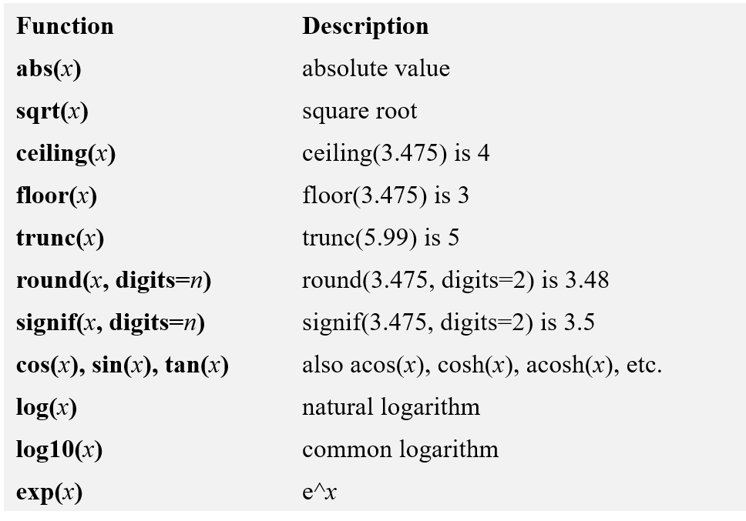
Manipulating Data
Built-in functions: Already provided in R.
Numeric Functions
Notes:
Demonstrate the GUI here. Go over tables databases, fields, and properties

Slide 10
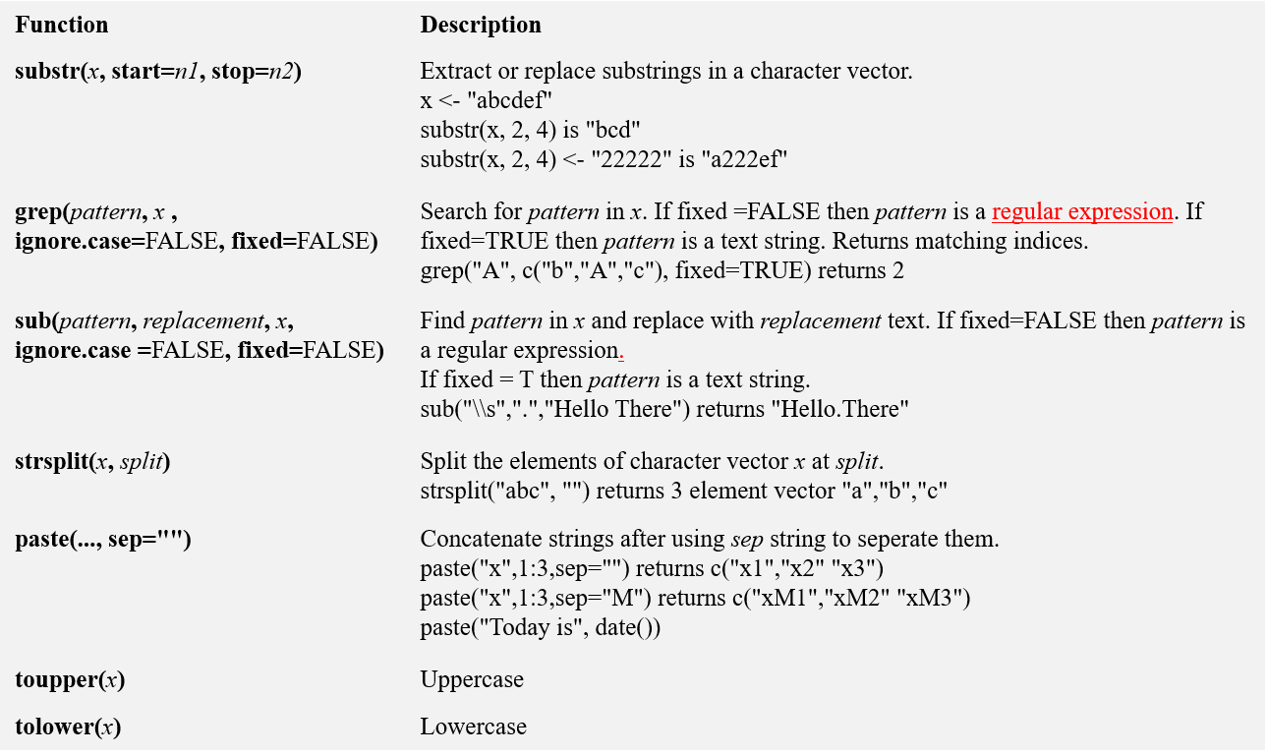
Manipulating Data
Character Functions
Notes:
Demonstrate the GUI here. Go over tables databases, fields, and properties

Slide 11
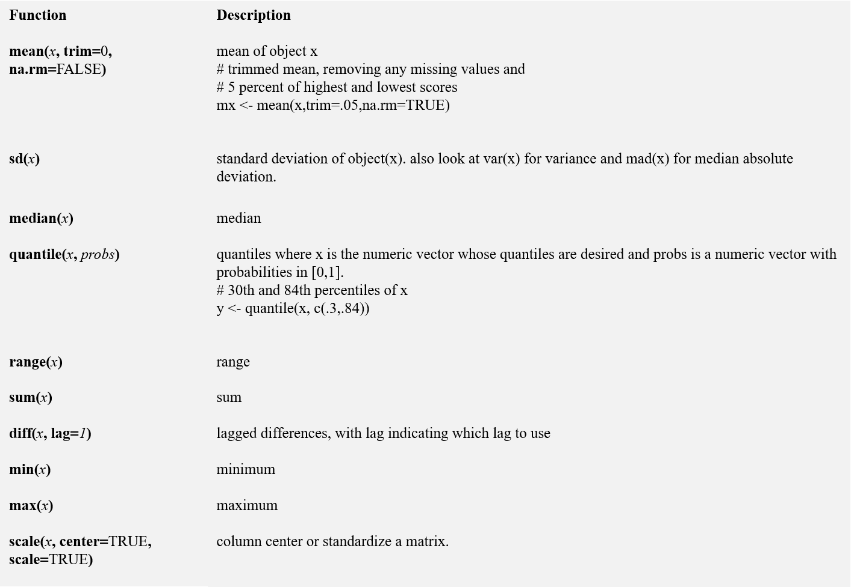
Manipulating Data
Statistical Functions
Notes:
Demonstrate the GUI here. Go over tables databases, fields, and properties

Slide 12
Manipulating Data
Other Useful functions:
length(object) # number of elements in vector/list
dim(object) # dimensions of matrix/dataframe
nrow/ncol(object) # number of rows/cols
(row/col)names(object) # (row/col) names of object
c(object,object,...) # combine objects into a vector
cbind(object, object, ...) # combine objects as columns
rbind(object, object, ...) # combine objects as rows
subset(dataframe, condition) # slices dataframe based on condition
which(condition) # returns indices of vector which satisfy the condition
match(vector1, vector2) # indices of vector 1 elements in vector 2
order(vector, decreasing = TRUE) # ordered indices of vector
merge(dataframe1, dataframe2, by = vector of fields) # SQL inner join
Notes:
Demonstrate the GUI here. Go over tables databases, fields, and properties

Slide 13
Manipulating Data
User-defined functions: Can define your own functions in R
<function name> <- function(<variables list>) {
<expr>
return(<output variable>)
}
Example:
add <- function(x, y) {
return(x + y)
}
Notes:
Demonstrate the GUI here. Go over tables databases, fields, and properties

Slide 14
Advanced Regression

Slide 15
Regression Analysis
R provides comprehensive support for multiple linear regression.
General Regression (built-in):
fit <- lm(y ~ x1 + x2 + x3, data=mydata)
fit <- glm(y ~ x1 + x2 + x3, data=mydata)
Lasso Regression (package glmnet):
fit <- glmnet(x, y, family=“gaussian”, alpha=1)
Ridge Regression (package glmnet):
fit <- glmnet(x, y, family=“gaussian”, alpha=0)
Elastic Net Regression (package glmnet):
fit <- glmnet(x, y, family=“gaussian”, alpha=0.5)
Predicting new results:
yhat <- predict(fit,xnew)
http://www4.stat.ncsu.edu/~post/josh/LASSO_Ridge_Elastic_Net_-_Examples.html
Notes:
Demonstrate the GUI here. Go over tables databases, fields, and properties

Slide 16
Regression Analysis
Multiple Linear Regression Example: fit <- lm(y ~ x1 + x2 + x3, data=mydata) summary(fit) # show results
Other useful functions: coefficients(fit) # model coefficients confint(fit, level=0.95) # CIs for model parameters fitted(fit) # predicted values residuals(fit) # residuals anova(fit) # anova table vcov(fit) # covariance matrix for model parameters influence(fit) # regression diagnostics
Predicting new results: yhat <- predict(fit,xnew)
Notes:
Demonstrate the GUI here. Go over tables databases, fields, and properties

Slide 17
Regression Analysis
General Regression Model:
fit <- glm(y~formula, data=mydata)
Building model for glmnet:
x <- model.matrix(~0+formula,data=mydata)
y <- mydata$y
fit <- glmnet(x, y, family=“Gaussian”, alpha=1)
Advanced regression formula:
Regression formula with categorical variables:
y ~ x1 + x2 + factor(x3)
Regression with interaction terms:
y ~ x1 + x2*x3
Regression with non-linear terms:
y ~ x1 + x2**2 + x3
Notes:
Demonstrate the GUI here. Go over tables databases, fields, and properties

Slide 18
Regression Analysis
Logistic regression in R:
General Regression (built-in):
fit <- lm(y ~ x1 + x2 + x3, data=mydata, family=“binomial”)
fit <- glm(y ~ x1 + x2 + x3, data=mydata, family=“binomial”)
Lasso Regression (package glmnet):
fit <- glmnet(x, y, family=“binomial”, alpha=1)
Ridge Regression (package glmnet):
fit <- glmnet(x, y, family=“binomial”, alpha=0)
Elastic Net Regression (package glmnet):
fit <- glmnet(x, y, family=“binomial”, alpha=0.5)
Predicting new results:
yhat <- predict(fit, xnew, type=“response”)
http://www4.stat.ncsu.edu/~post/josh/LASSO_Ridge_Elastic_Net_-_Examples.html
Notes:
Demonstrate the GUI here. Go over tables databases, fields, and properties

Slide 19
Advanced Plotting

Slide 20
Plotting Results
One of the main reasons data analysts turn to R is for its strong graphic capabilities.
Here we will cover some of the basic plotting capabilities in R
Scatter Plots: plot(x,y)
Example: attach(mtcars) plot(wt, mpg) abline(lm(mpg~wt), col=“red) title("Regression of MPG on Weight")
Notes:
Demonstrate the GUI here. Go over tables databases, fields, and properties

Slide 21
Plotting Results
Histograms: hist(x)
Example: x <- mtcars$mpg
h<-hist(x, breaks=10, col="red", xlab="Miles Per Gallon", main="Histogram with Normal Curve")
xfit<-seq(min(x),max(x),length=40)
yfit<-dnorm(xfit,mean=mean(x),sd=sd(x))
yfit <- yfit*diff(h$mids[1:2])*length(x)
lines(xfit, yfit, col="blue", lwd=2)
Notes:
Demonstrate the GUI here. Go over tables databases, fields, and properties

Slide 22
Plotting Results
Bar Plots: barplot(x)
Example:
# Simple Horizontal Bar Plot with Added Labels counts <- table(mtcars$gear)
barplot(counts, main="Car Distribution", horiz= TRUE, names.arg=c("3 Gears", "4 Gears", "5 Gears"), col="red")
Notes:
Demonstrate the GUI here. Go over tables databases, fields, and properties

Slide 23
Plotting Results
Box Plots: boxplots(y~x, data=mydata)
Example:
# Boxplot of MPG by Car Cylinders
boxplot(mpg~cyl,data=mtcars, main=“Car Milage Data”, xlab=“Number of Cylinders”, ylab=“Miles Per Gallon”, col=“red”)
Notes:
Demonstrate the GUI here. Go over tables databases, fields, and properties

Slide 24
Plotting Results
Line charts: lines(x, y, type=“l”)
Example:
x <- c(1:5); y <- x # create some data
par(pch=22, col="red") # plotting symbol and color
par(mfrow=c(2,4)) # all plots on one page
opts = c("p","l","o","b","c","s","S","h")
for(i in 1:length(opts)){
heading = paste("type=",opts[i])
plot(x, y, type="n", main=heading)
lines(x, y, type=opts[i])
}
Notes:
Demonstrate the GUI here. Go over tables databases, fields, and properties

Slide 25
R Markdown

Slide 26
R Markdown
R Markdown is very useful for creating professional reports with embedded R plots.
It uses R and Latex. You need to have Latex installed in computer to use this.
Useful link: http://rmarkdown.rstudio.com/articles_intro.html
Demo
Notes:
Demonstrate the GUI here. Go over tables databases, fields, and properties

Slide 27
Conclusion
Provided more advanced overview of R
Much more functionality available
Resources to use:
https://cran.r-project.org/
https://stackoverflow.com/
Notes:
Demonstrate the GUI here. Go over tables databases, fields, and properties

Slide 28
Thank you

